Slide 1


Green Pace
Security Policy Presentation
Developer: Jessica Ayer
Security standards, principles, and coding practices
https://youtu.be/9uySd6nbXlQ
Notes:
This presentation will introduce you to Green Pace’s new security policy. The policy is designed to support the transition from a DevOps to a DevSecOps workflow. It covers both what standards and policies are being implemented as well as why.

Slide 2

OVERVIEW: DEFENSE IN DEPTH
Implementing multiple layers of security to protect your data.
Notes:
Defense in Depth protects your data. It is the practice of implementing multiple layers of security measures to protect one’s assets. These layers include but are not limited to antivirus software, firewalls, secure gateways, and best coding practices. Each layer filters out more vulnerabilities to create an overlapping net and preventing security breaches from penetrating though any individual layer’s holes. It can also thwart attacks that have already breached the system. Human negligence is often what lead to security breaches so practicing Defense in Depth is crucial.

Slide 3
THREATS MATRIX
Likely There is a high chance of a flaw being introduced that could lead to an exploitable vulnerability. STD-002-CPP STD-003-CPP STD-004-CPP STD-005-CPP STD-008-CPP STD-0010-CPP | Priority Standards with a high relevancy. STD-003-CPP STD-004-CPP STD-005-CPP
Low priority Standards with a low relevancy. STD-001-CPP STD-006-CPP STD-007-CPP STD-009-CPP | Unlikely There is a low chance of a flaw being introduced that could lead to an exploitable vulnerability. STD-001-CPP STD-006-CPP STD-009-CPP
Notes:
The matrix shows how the severity level is assessed for each coding standard. A Static analysis test can be used to detect these threats and offer suggestions for correction. As you can see standards 3, 4, and 5 address issues that are both likely to lead to a vulnerability and have high relevance.

Slide 4
10 PRINCIPLES
Principle | Applicable Standards
Validate Input Data | STD-001-CPP, STD-002-CPP, STD-003-CPP, STD-004-CPP, STD-008-CPP
Heed Compiler Warnings | STD-001-CPP, STD-006-CPP, STD-007-CPP
Architect and Design for Security Policies | STD-004-CPP, STD-009-CPP
Keep it Simple | STD-001-CPP, STD-005-CPP, STD-008-CPP, STD-010-CPP
Default Deny | STD-001-CPP, STD-003-CPP, STD-004-CPP, STD-008-CPP, STD-009-CPP
Adhere to the Principle of Least Privilege | STD-004-CPP, STD-009-CPP
Sanitize Data Sent to Other Systems | STD-004-CPP, STD-010-CPP
Practice Defense in Depth | STD-001-CPP, STD-002-CPP, STD-003-CPP, STD-005-CPP, STD-006-CPP, STD-007-CPP, STD-009-CPP
Use Effective Quality Assurance Techniques | STD-002-CPP, STD-003-CPP, STD-005-CPP, STD-006-CPP, STD-007-CPP, STD-010-CPP
Adopt a Secure Coding Standard | STD-001-CPP, STD-002-CPP, STD-003-CPP, STD-004-CPP
Notes:
This slide shows a list of the top 10 secure coding principles.
Validate Input data
Heed Compiler Warnings
Architect and Design for Security Policies
Keep it Simple
Default Deny
Adhere to the Principles of Least Privilege
Sanitize Data Sent to Other Systems
Practice Defense in Depth
Use Effective Quality Assurance Techniques
Adopt a Secure Coding Standard
For details on each principle see the Security Policy Documentation.

Slide 5
CODING STANDARDS
Listed from the highest priority standards to the lowest based off of severity and likely hood of creating an exploitable vulnerability if ignored.
Priority Level | Label | Name of Standard
5 | STD-008-CPP | Guarantee that container indices and iterators are within the valid range
5 | STD-003-CPP | Guarantee that storage for strings has sufficient space
5 | STD-004-CPP | Sanitize all input data
5 | STD-005-CPP | Do not access dangling pointers
4 | STD-002-CPP | Make sure that performing operations with signed integers does not result in overflow
4 | STD-010-CPP | Copy operations must not mutate the source object
3 | STD-007-CPP | Handle all exceptions
3 | STD-009-CPP | Close files when they are no longer needed
2 | STD-001-CPP | Understand the size of standard data types
1 | STD-006-CPP | Use a static assertion to test the value of a constant expression
Notes:
The coding standards listed from the highest priority to the lowest based off severity and likelyhood of creating an exploitable vulnerability are:
Guarantee that container indices and iterators are within the valid range
Guarantee that storage for strings has sufficient space
Sanitize all input data
Do not access dangling pointers
Make sure that performing operations with signed integers does not result in overflow
Copy operations must not mutate the source object
Handle all exceptions
Close files when they are no longer needed
Understand the size of standard data types
Use a static assertion to test the value of a constant expression
Notice the top priorities all refer to memory management vulnerabilities.
Once again, details for each standard can be found in the Security Policy Documentation.

Slide 6
ENCRYPTION POLICIES
Encryption at Rest
Encryption at Flight
Encryption in Use
Notes:
Three key encryption policies will be implemented to protect Green Pace’s data.
Encryption at Rest protects stored data when it is not in use to prevent an attacker from gaining access even if they can access the storage server. Identify the data, how it is stored, and who needs access to decrypt it. Block all other potential users from reading the data.
Encryption at Flight protects data as it is transfered from its resting location to the user. We can prevent “Eavesdroppers” by using both symmetric and asymmetric key encryption.
Encryption in Use protects data while it is being accessed by a user. Utilize AES-256 encryption in all data fields and analyze data requests in real time to block suspicious requests.

Slide 7
TRIPLE-A POLICIES
Who are you?
What resources are you permitted to use?
What resources were accessed, at what time, by whom, and what commands were issued?
Authentication
Authorization
Accounting
Notes:
The Triple-A policies address the questions:
who are you?
What resources are you permitted to use?
What resources were accessed, at what time, by whom, and what commands were issued?
This is done through:
Authentication: Identifying a user and verifying that they are who they claim to be with a unique set of credentials
Authorization: Determining what access level a user is granted to the system and what functions they can perform
Accounting: Documenting what resources and the timeframe each user utilizes while accessing the system.

Slide 8
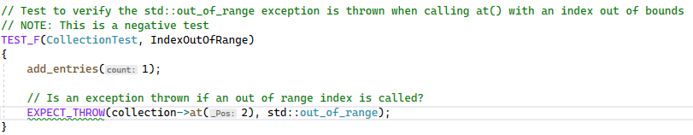
Unit Testing
Index Out Of Range
Notes:
The next few slides are examples of unit tests.
The first checks to see if container indices and iterators are within the valid range. The test is checking to make sure an exception is thrown if an out-of-range index is called.
You need to verify that an index call is not out-of-bounds. If you use an iterator that is out-of-range overflow may occur.

Slide 9
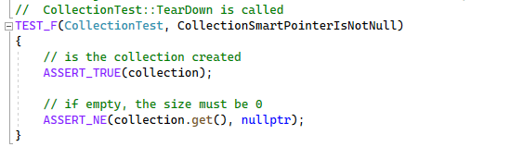
Unit Testing
Collection Smart Pointer Is Not Null
Notes:
The second example addresses pointers.
Here we are testing to see if a pointer is NULL. Accessing a dangling pointer will result in undefined behavior and exploitable vulnerabilities.

Slide 10
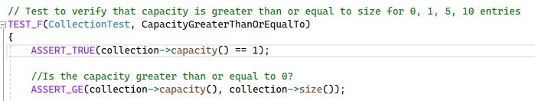
Unit Testing
Capacity Greater Than or Equal To
Notes:
Example three makes sure there is sufficient space available for the data type or in a container before trying to add values.
By making sure the capacity of a container is large enough for the data we desire it to hold we prevent improper memory management that could create vulnerabilities. This slide shows a failed test. The container “collection” has a capacity of zero and therefore cannot hold data without being resized.

Slide 11
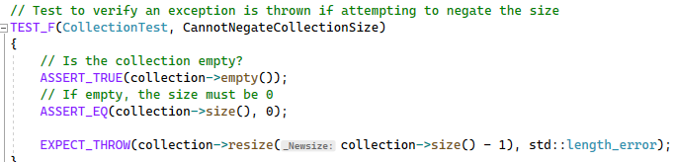
Unit Testing
Cannot Negate Collection Size
Notes:
The fourth and last unit test example in this presentation checks to make sure the size of a container cannot be negated. An exception is thrown if the user attempts to negate the size. It is important to know what data type is being used and what size range it can be to prevent underflow or overflow.

Slide 12

AUTOMATION SUMMARY
Notes:
This visual show the Pipeline for DevSecOps and how automation can be incorporated into the software development lifecycle. As you can see, security has been brought to the forefront of every phase.

Slide 13
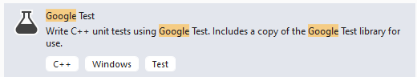
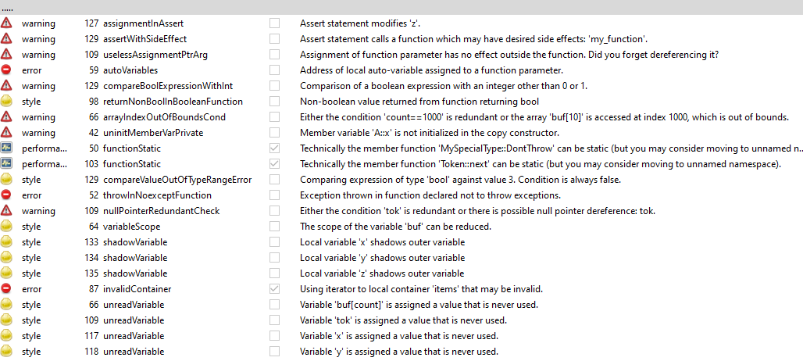
TOOLS
Development, Security and Operations (DevSecOp): Integrating security into each phase of the software development lifecycle with automation tools(IBM 2020).
Google Test
CPPcheck
Notes:
DevSecOps stands for Development, Security, and Operations. It integrates security into each phase of the software development lifecycle with automation tools. Security protocols should be implemented when planning, designing, building, testing, and maintaining the system.
The tools that were used to run some sample testing for Green Pace were Google Test and CPPcheck.
Google Test was used for the unit tests. It is simple to use and integrates right into the IDE.
CPPcheck is one of many available static analysis testing application. The tool is used to discover warnings, and errors in the developed code. It offers a short description and suggestions on how to fix each of the issues found.

Slide 14
RISKS AND BENEFITS
Now
Risks
Lack of training
More upfront costs
Benefits
Catch vulnerabilities sooner and protecting your data now
Code will be more secure from day one and require less remediation
Wait
Risks
Insecure code
Security gaps due to manual testing process
Costly to fix vulnerabilities after completion of development
Benefits
The development team will have more time to be educated on the automation tool and learn how to implement them correctly
Faster code development
Current production cycle not interrupted
Notes:
There are always going to be risks and benefits to adopting a new workflow. If Green Pace chooses to adopt DevSecOps right now.
Risks would include:
Lack of training
More upfront costs
The benefits to switching to DevSecOps right now include:
Catching vulnerabilities sooner and protecting your data now.
Code being more secure sooner rather than later resulting in less remediation.
Should Grean Pace prefer to wait until later to implement DevSecOps Risks include:
Insure code
Security gaps due to manual testing practices
More remediation which is costly when development is already complete
Benefits to waiting are:
More time to learn the new tools and become comfortable with change
Faster code development as the developers won’t be bogged down with new requirements
The current production cycle will not be interrupted and therefore deadlines will not be effected.

Slide 15
RECOMMENDATIONS
Slowly introduce the DevSecOp pipeline into the software development lifecycle. Start with Secure coding standards then introduce new automated testing tools one at time.
Research the appropriate unit testing platform and static analysis applications and thoroughly educate the team before implementation.
Define user roles and their access levels and implement a Tripple A framework
Make sure data is always encrypted
Always Practice Defense in Depth
Notes:
Here are some recommendations:
Slowly introduce the DevSecOps pipeline into the software development lifecycle. Start with Secure coding standards then introduce new automated testing tools one at time.
Research the appropriate unit testing platform and static analysis applications and thoroughly educate the team before implementation.
Define user roles and their access levels and implement a Tripple A framework.
Make sure data is always encrypted.
Always Practice Defense in Depth

Slide 16
CONCLUSIONS
Practicing security from start to finish with DevSecOps by following secure coding practices, using a Triple-A framework, constant data encryption, and adopting automated tools will help protect Green Pace from falling victim to an attack. A Defense in Depth strategy will give your clients peace of mind and allow them to trust Green Pace with their sensitive data.
Notes:
Practicing security from start to finish with DevSecOps by following secure coding practices, using a Triple-A framework, constant data encryption, and adopting automated tools will help protect Green Pace from falling victim to an attack. A Defense in Depth strategy will give your clients peace of mind and allow them to trust Green Pace with their sensitive data.

Slide 17
REFERENCES
Ayer, Jessica (December 4, 2022). Green Pace Secure Development Policy. https://github.com/JessAyer/CS405-Secure-Coding/blob/main/CS%20405%20Security%20Policy.docx
Brightline IT (May 17, 2017). What is Encryption at Rest, and Why Is It Important for Your Business?. https://brightlineit.com/encryption-at-rest-important-business/
Confluence Admin (November 18, 2020). SEI Cert Coding Standards. https://wiki.sei.cmu.edu/confluence/display/seccode/SEI+CERT+Coding+Standards
Das, Purandar. In-Use Encryption – What It Is and How companies Benefit. Sotero. https://www.soterosoft.com/blog/data-in-use-encryption-data-in-motion-encryption/
Fortinet (2022). Defense in Depth. Fortinet, Inc. https://www.fortinet.com/resources/cyberglossary/defense-in-depth
IBM Cloud Education (July 20, 2020). What is DevSecOps?. IBM https://www.ibm.com/cloud/learn/devsecops
Lo Faso, Vince (April 28, 2015). How To Protect Data in Flight. Skillsoft. https://www.globalknowledge.com/us-en/resources/resource-library/articles/how-to-protect-data-in-flight/
Mylonas, Leo (November 27, 2018). What is AAA security? An introduction to authentication, authorization, and accounting. Codebots. https://codebots.com/application-security/aaa-security-an-introduction-to-authentication-authorisation-accounting
Notes:
Thank you for taking the time to watch this presentation.

